Slide 1
Introduction to Probability Part 1
Data Science for Quality Management: Probability and Probability Distributions
with Wendy Martin

Slide 2
Learning objectives:
Describe the concept of probability
Use the rules of probability to perform basic probability calculations

Slide 3
Probability Definitions
Probability is the chance that an event will or will not occur. The terms are typically expressed in fractions or decimals.
An event is one or more of the possible outcomes of a situation or experiment

Slide 4
Probability Definitions
An experiment is an activity which produces an event.
Sample space is the set of all possible outcomes from an experiment

Slide 5
Probability Definitions
Events are termed mutually exclusive when one and only one can take place at the same time.
Collectively Exhaustive refers to lists containing all of the possible events which may result from an experiment.

Slide 6
Classical Probability
The probability that an event will occur
where
P = Probability of an event
N = Number of outcomes where the event occurs
S = Total Number of possible outcomes; and where each of the possible outcomes are equally likely

Slide 7
Rules / Conditions of Probability
Typical conditions of concern:
The case where one event or another will occur
The situation with two or more events where both may occur

Slide 8
Marginal or Unconditional Probability
P(A) = the probability P of event A occurring
Where a single probability is involved, only one event can take place

Slide 9
Marginal or Unconditional Probability Example
A production lot of 100 parts contains one defective part. What is the P of selecting one part randomly from the lot, and drawing the defective?

Slide 10
Marginal or Unconditional Probability Example
1
𝑃 𝐷 =
= 0.01 = 1.0%
100

Slide 11
Addition Rule for Mutually Exclusive Events
P(A or B) = P(A) + P(B)

Slide 12
Addition Rule for Mutually Exclusive Events Example
Suppose an investigator has planned to run an experiment, where they wish to select two machines randomly from the ten units on the floor for testing.

Slide 13
Addition Rule for Mutually Exclusive Events Example
If each machine is numbered from 1 to 10, what is the probability that machine 4 or 8 will be selected on a single draw?
P(4 or 8) = P(4) + P(8)
1 1
2
=
+ = = 0.2 𝑜𝑟 20%
10 10 10

Slide 14
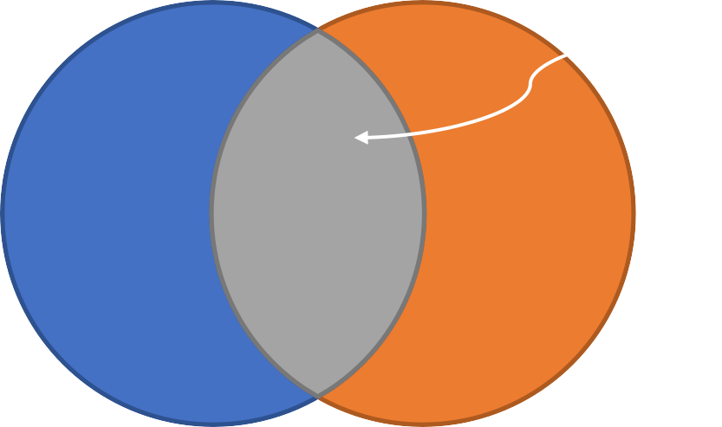
Addition Rule for Non-Mutually Exclusive Events
P(A or B) = P(A) + P(B) – P(A+B)
Subtract overlap
A B

Slide 15
Addition Rule for Non-Mutually Exclusive Events Example
Given a mixed lot with the following characteristics:
Vendor | # Defective | # Not Defective
Vendor A | 15 | 85
Vendor B | 10 | 55

Slide 16
Addition Rule for Non-Mutually Exclusive Events Example
What is the probability, on a single random draw, of selecting a part from Vendor A or a defective part?

Slide 17
Addition Rule for Non-Mutually Exclusive Events Example
If we were to simply use P(A) + P(B), then

Slide 18
Addition Rule for Non-Mutually Exclusive Events Example
Note, however, that there are 15 more parts credited to the total than should be!
Vendor | # Defective | # Not Defective
Vendor A | 15 | 85
Vendor B | 10 | 55

Slide 19
Addition Rule for Non-Mutually Exclusive Events Example
P(A and B) =
So, P(A or B) = P(A) + P(B) – P(A+B)

Slide 20
Addition Rule for Non-Mutually Exclusive Events Example
P(Vendor A or Defective) =

Slide 21
Sources
The material used in the PowerPoint presentations associated with this course was drawn from a number of sources. Specifically, much of the content included was adopted or adapted from the following previously-published material:
Luftig, J. An Introduction to Statistical Process Control & Capability. Luftig & Associates, Inc. Farmington Hills, MI, 1982
Luftig, J. Advanced Statistical Process Control & Capability. Luftig & Associates, Inc. Farmington Hills, MI, 1984.
Luftig, J. A Quality Improvement Strategy for Critical Product and Process Characteristics. Luftig & Associates, Inc. Farmington Hills, MI, 1991
Luftig, J. Guidelines for Reporting the Capability of Critical Product Characteristics. Anheuser-Busch Companies, St. Louis, MO. 1994
Spooner-Jordan, V. Understanding Variation. Luftig & Warren International, Southfield, MI 1996
Luftig, J. and Petrovich, M. Quality with Confidence in Manufacturing. SPSS, Inc. Chicago, IL 1997
Littlejohn, R., Ouellette, S., & Petrovich, M. Black Belt Business Improvement Specialist Training, Luftig & Warren International, 2000
Ouellette, S. Six Sigma Champion Training, ROI Alliance, LLC & Luftig & Warren, International, Southfield, MI 2005

Slide 22
Introduction to Probability Part 2
Data Science for Quality Management: Probability and Probability Distributions
with Wendy Martin

Slide 23
Learning objectives:
Discriminate between marginal, joint and conditional probabilities
Discriminate between independent and dependent events

Slide 24
Learning objectives:
Calculate marginal, joint, and conditional probability under independent and dependent conditions.

Slide 25
Statistical Independence and Dependence
Events which are statistically independent are those where the outcome of one event has no effect on the outcome of the second event

Slide 26
Statistical Independence and Dependence
Events which effect subsequent events are termed dependent.

Slide 27
Independent Conditions –
Marginal Probability
P(A) Independent Event (e.g. coin toss)

Slide 28
Independent Conditions – Joint Probability
The probability of two or more events occurring together (or in succession) is the product of their marginal probabilities
P(AB) = P(A) x P(B), where

Slide 29
Independent Conditions – Joint Probability
P(AB) = probability of events A and B occurring together or in succession; joint probability
P(A) = marginal probability of (A)
P(B) = marginal probability of (B)

Slide 30
Independent Conditions – Joint Probability Example 1
The probability of a machine operator producing a defective part at any point in time is 0.05. What is the probability that three bad parts will be produced in succession?

Slide 31
Independent Conditions – Joint Probability Example 1
P(ABC) = P(A) x P(B) x P(C)
P(3 Defectives) = P(Def) x P(Def) x P(Def)
P(3 Def) = 0.05 x 0.05 x 0.05
P(3 Def) = 0.000125

Slide 32
Independent Conditions –
Conditional Probability
P(B|A) = Probability of event B occurring, given that A has occurred.
P(B|A) = P(B)…because A and B are
independent!

Slide 33
Dependent Conditions –
Conditional Probability
Note that this is equivalent to calculating the probability of the part being defective, given a sample space of B, after A has been drawn.

Slide 34
Dependent Conditions –
Conditional Probability Example
Assuming a randomly selected part is from Vendor A, what is the P that it is also defective?
Vendor | # Defective | # Not Defective | Total
Vendor A | 15 | 85 | 100
Vendor B | 10 | 55 | 65
Total | 25 | 140 | 165

Slide 35
Dependent Conditions –
Conditional Probability Example

Slide 36
Dependent Conditions –
Conditional Probability Example
Vendor | # Defective | # Not Defective | Total
Vendor A | 15 | 85 | 100
Vendor B | 10 | 55 | 65
Total | 25 | 140 | 165
Note: This is the same as observing that given the 15 defectives out of 100 Vendor A parts, then

Slide 37
Dependent Conditions
Note also that the P(Defective and Vendor A) constitutes a joint probability under statistical dependence. Creating a table of joint P values for the sample space:
Event | P | Fraction
Vendor A and Defective | 0.0909 | ^{15ൗ}165
Vendor A and Not Defective | 0.5151 | ^{85ൗ}165
Vendor B and Defective | 0.0606 | ^{10ൗ}165
Vendor B and Not Defective | 0.3333 | ^{55ൗ}165

Slide 38
Dependent Conditions –
Conditional Probability Example
As a second example, assume that a non- defective part has been drawn. What is the P that it is from Vendor B?

Slide 39
Dependent Conditions –
Conditional Probability Example
Note that should a non-defective part have been selected, the P of it being a part from Vendor B is

Slide 40
Joint Probabilities Under Statistical Dependence
The formula for joint probabilities under statistical dependence is a variation of the conditional probability formula

Slide 41
Joint Probabilities Under Statistical Dependence
𝑃(𝐵𝐴)
𝑃(𝐵|𝐴) = 𝑃 𝐵𝐴 = 𝑃 𝐵 𝐴
𝑥 𝑃(𝐴)
𝑃(𝐴)
Noting that
𝑃 𝐵𝐴 = 𝑃(𝐴𝐵)
And that P(BA) = P of events B and A happening together or in succession

Slide 42
Joint Probabilities Under Statistical Dependence Example
As an example, we can check any of the joint probability calculations from the joint P table; for example,
P(A and Def) = 0.0909 or ¹⁵Τ₁₆₅

Slide 43
Joint Probabilities Under Statistical Dependence Example
𝑃 𝐵𝐴 = 𝑃 𝐵 𝐴 𝑥 𝑃(𝐴)
𝑃(𝐵𝐴)
𝑃 𝐵𝐴 =
𝑥 𝑃 𝐴
𝑃(𝐴)
𝑃 𝐴 𝑎𝑛𝑑 𝐷𝑒𝑓
0.0909
𝑥 𝑃 𝐷𝑒𝑓 =
𝑥 0.1515 = 0.0909
𝑃 𝐷𝑒𝑓
0.1515

Slide 44
Sources
The material used in the PowerPoint presentations associated with this course was drawn from a number of sources. Specifically, much of the content included was adopted or adapted from the following previously-published material:
Luftig, J. An Introduction to Statistical Process Control & Capability. Luftig & Associates, Inc. Farmington Hills, MI, 1982
Luftig, J. Advanced Statistical Process Control & Capability. Luftig & Associates, Inc. Farmington Hills, MI, 1984.
Luftig, J. A Quality Improvement Strategy for Critical Product and Process Characteristics. Luftig & Associates, Inc. Farmington Hills, MI, 1991
Luftig, J. Guidelines for Reporting the Capability of Critical Product Characteristics. Anheuser-Busch Companies, St. Louis, MO. 1994
Spooner-Jordan, V. Understanding Variation. Luftig & Warren International, Southfield, MI 1996
Luftig, J. and Petrovich, M. Quality with Confidence in Manufacturing. SPSS, Inc. Chicago, IL 1997
Littlejohn, R., Ouellette, S., & Petrovich, M. Black Belt Business Improvement Specialist Training, Luftig & Warren International, 2000
Ouellette, S. Six Sigma Champion Training, ROI Alliance, LLC & Luftig & Warren, International, Southfield, MI 2005

Slide 45
Probability Distributions Part1
Data Science for Quality Management: Probability and Probability Distributions
with Wendy Martin

Slide 46
Learning objective:
Describe the concept of a probability distribution

Slide 47
Probability Distributions
Probability distributions are theoretical frequency distributions which are collectively exhaustive.

Slide 48
Probability Distributions
For example, suppose we have historical evidence to show that a particular vendor will provide a defective part to us 20 times out of
100. Therefore, the P of receiving a Defective part (D) is:

Slide 49
Probability Distributions
Let us determine the probabilities associated with any two parts randomly drawn from a large production lot. Given:
1st Part | 2nd Part | # Def. @ 2 parts | P
D (0.20) | ND (0.80) | 1 | 0.16
D (0.20) | D (0.20) | 2 | 0.04
ND (0.80) | D (0.20) | 1 | 0.16
ND (0.80) | ND (0.80) | 0 | 0.64
 |  | Total | 1.00

Slide 50
Probability Distributions
We can now create a probability distribution conforming to our theoretical expectation for two parts so that:
# of Defectives | Draws | P(D)
0 | (ND, ND) | 0.64
1 | (ND, D) + (D, ND) | 0.32
2 | (D,D) | 0.04

Slide 51
Probability Distributions
In R / Rstudio
table.dist.binomial(n, p)

Slide 52
Sources
The material used in the PowerPoint presentations associated with this course was drawn from a number of sources. Specifically, much of the content included was adopted or adapted from the following previously-published material:
Luftig, J. An Introduction to Statistical Process Control & Capability. Luftig & Associates, Inc. Farmington Hills, MI, 1982
Luftig, J. Advanced Statistical Process Control & Capability. Luftig & Associates, Inc. Farmington Hills, MI, 1984.
Luftig, J. A Quality Improvement Strategy for Critical Product and Process Characteristics. Luftig & Associates, Inc. Farmington Hills, MI, 1991
Luftig, J. Guidelines for Reporting the Capability of Critical Product Characteristics. Anheuser-Busch Companies, St. Louis, MO. 1994
Spooner-Jordan, V. Understanding Variation. Luftig & Warren International, Southfield, MI 1996
Luftig, J. and Petrovich, M. Quality with Confidence in Manufacturing. SPSS, Inc. Chicago, IL 1997
Littlejohn, R., Ouellette, S., & Petrovich, M. Black Belt Business Improvement Specialist Training, Luftig & Warren International, 2000
Ouellette, S. Six Sigma Champion Training, ROI Alliance, LLC & Luftig & Warren, International, Southfield, MI 2005

Slide 53
Probability Distributions Part 2
Data Science for Quality Management: Probability and Probability Distributions
with Wendy Martin

Slide 54
Learning objectives:
Discriminate between discrete and continuous probability distributions
Identify the probability distributions most commonly used in decision making

Slide 55
Types of Probability Distributions
Discrete – A discrete probability distribution is one where there are a limited number of possible values

Slide 56
Types of Probability Distributions
Continuous – A continuous probability distribution has relatively unlimited possibilities for variable values

Slide 57
Random Variables
A random variable is one which can take on different values as a result of the outcomes of a random experiment.
Random variables, further, can be either discrete or continuous.

Slide 58
Probability Distribution for Discrete Random Variable
Assume that an automated process produces between 50 and 60 parts per day. During a two month production period, daily production levels (DP) were noted and the following data were generated:

Slide 59
Daily Production (DP) | # of Days | P(DP)
50 | 1 | 0.027
51 | 2 | 0.054
52 | 2 | 0.054
53 | 3 | 0.081
54 | 5 | 0.135
55 | 7 | 0.189
56 | 6 | 0.162
57 | 4 | 0.108
58 | 4 | 0.108
59 | 2 | 0.054
60 | 1 | 0.027
 | ∑f = 37 | 1.000

Slide 60
Probability Distribution for Discrete Random Variable
R / Rstudio
frequency.dist.grouped( )

Slide 61
Expected Value of a Discrete Random Variable
One of the most important factors related to any probability distribution is the ability to define the expected value of a random variable.

Slide 62
Expected Value of a Discrete Random Variable
The expected value of a discrete random variable is the weighted average of the expected outcomes.

Slide 63
Daily Production (DP) | P | Weighted P Value (DP x P)
50 | 0.027 | 1.351
51 | 0.054 | 2.757
52 | 0.054 | 2.811
53 | 0.081 | 4.297
54 | 0.135 | 7.297
55 | 0.189 | 10.405
56 | 0.162 | 9.081
57 | 0.108 | 6.162
58 | 0.108 | 6.270
59 | 0.054 | 3.189
60 | 0.027 | 1.621
 | Sum | 55.243

Slide 64
Expected Value of a Discrete Random Variable
Therefore, E(DP) = 55.243

Slide 65
Expected Value of a Discrete Random Variable
R / R Studio
weighted.mean(x,y) OR
mean( )

Slide 66
Some Commonly-Employed Probability Distributions
Discrete Binomial Poisson Hypergeometric Geometric
Continuous Normal Exponential Weibull Family Johnson Family
Other Distributions

Slide 67
Sources
The material used in the PowerPoint presentations associated with this course was drawn from a number of sources. Specifically, much of the content included was adopted or adapted from the following previously-published material:
Luftig, J. An Introduction to Statistical Process Control & Capability. Luftig & Associates, Inc. Farmington Hills, MI, 1982
Luftig, J. Advanced Statistical Process Control & Capability. Luftig & Associates, Inc. Farmington Hills, MI, 1984.
Luftig, J. A Quality Improvement Strategy for Critical Product and Process Characteristics. Luftig & Associates, Inc. Farmington Hills, MI, 1991
Luftig, J. Guidelines for Reporting the Capability of Critical Product Characteristics. Anheuser-Busch Companies, St. Louis, MO. 1994
Spooner-Jordan, V. Understanding Variation. Luftig & Warren International, Southfield, MI 1996
Luftig, J. and Petrovich, M. Quality with Confidence in Manufacturing. SPSS, Inc. Chicago, IL 1997
Littlejohn, R., Ouellette, S., & Petrovich, M. Black Belt Business Improvement Specialist Training, Luftig & Warren International, 2000
Ouellette, S. Six Sigma Champion Training, ROI Alliance, LLC & Luftig & Warren, International, Southfield, MI 2005

Slide 68
The Binomial Distribution
Data Science for Quality Management: Probability and Probability Distributions
with Wendy Martin

Slide 69
Learning objectives:
Describe the Binomial probability distribution
Calculate probabilities using the Binomial distribution

Slide 70
The Binomial Distribution
The Binomial distribution relates to a discrete random variable (nominal data).
The basis of this distribution is the Bernoulli process.

Slide 71
The Bernoulli Process
Each trial or experiment has only two possible outcomes
The P of any and all outcomes remains fixed over time
The trials or experiments are statistically independent

Slide 72
The Binomial Formula
𝑛!
_{𝑝}𝑟
_{𝑞}𝑛−𝑟
𝑃 𝑟 𝑖𝑛 𝑛 𝑡𝑟𝑖𝑎𝑙𝑠 =
𝑟! 𝑛 − 𝑟 !
where
p = probability of occurrence
q = 1-p = probability of failure
r = number of occurrences desired n = number of trials

Slide 73
Binomial Example
A vendor frequently ships 2 bad parts out of 10.
Suppose the vendor ships our company 50 parts. If we tell them that at least 9 parts out of 10 must be good, and nothing in their manufacturing process has changed, what is the P that we will receive what we asked for?

Slide 74
Binomial Example
p = 0.80, q = 0.20, r = 45, n = 50
50!
𝑃 45 𝑖𝑛 50 =
= 0.02953
0.8⁴⁵ 0.2⁵
45! 50 − 45 !

Slide 75
Binomial Example
What if we wanted to know the probability of getting at least 9 out of 10 good parts in the shipment of 50? P ≥ 45?
We would sum the following:
P(45) + P(46) + P(47) + P(48) + P(49)+P(50)

Slide 76
Probability Distributions
In R / Rstudio
table.dist.binomial(n, p)
pbinom( )

Slide 77
The Poisson Distribution
This probability distribution is for discrete random variables which can take integer (whole) values (ordinal data).

Slide 78
Poisson Data Examples
The number of parts produced during a 10 minute period
The number of breakdowns per shift
The number of failures per 100 cycles

Slide 79
The Poisson Formula
𝑋
₌ ^{𝜆} _{𝑒}−𝜆
𝑃 𝑋
𝑋!
where
P(X) = probability exactly X occurrences
λ = Mean number of occurrences per time interval (or unit) e = 2.71828

Slide 80
Poisson Example
λ = 25 parts produced per hour
X = 10 parts produced in one hour
₂₅10
_{𝑒}−25
𝑃 10 =
10!
= 0.0000365

Slide 81
Probability Distributions
In R / Rstudio
table.dist.poisson(λ)
ppois( )

Slide 82
Test for Poisson Distribution
In R / Rstudio
poisson.dist.test( )

Slide 83
Sources
Luftig, J. An Introduction to Statistical Process Control & Capability. Luftig & Associates, Inc. Farmington Hills, MI, 1982

Slide 84
The Poisson Distribution
Data Science for Quality Management: Probability and Probability Distributions
with Wendy Martin

Slide 85
Learning objectives:
Describe the Poisson probability distribution
Calculate probabilities using the Poisson distribution

Slide 86
The Poisson Distribution
This probability distribution is for discrete random variables which can take integer (whole) values (ordinal data).

Slide 87
Poisson Data Examples
The number of parts produced during a 10 minute period
The number of breakdowns per shift
The number of failures per 100 cycles

Slide 88
The Poisson Formula
𝑋
₌ ^{𝜆} _{𝑒}−𝜆
𝑃 𝑋
𝑋!
where
P(X) = probability exactly X occurrences
λ = Mean number of occurrences per time interval (or unit) e = 2.71828

Slide 89
Poisson Example
λ = 25 parts produced per hour
X = 10 parts produced in one hour
₂₅10
_{𝑒}−25
𝑃 10 =
10!
= 0.0000365

Slide 90
The Poisson Distribution in R
In R / Rstudio
table.dist.poisson(λ)
ppois( )

Slide 91
Test for Poisson Distribution
In R / Rstudio
poisson.dist.test( )

Slide 92
Sources
Luftig, J. An Introduction to Statistical Process Control & Capability. Luftig & Associates, Inc. Farmington Hills, MI, 1982

Slide 93
The Normal Distribution
Data Science for Quality Management: Probability and Probability Distributions
with Wendy Martin

Slide 94
Learning objectives:
Describe the Normal probability distribution
Calculate probabilities using the standard normal distribution

Slide 95
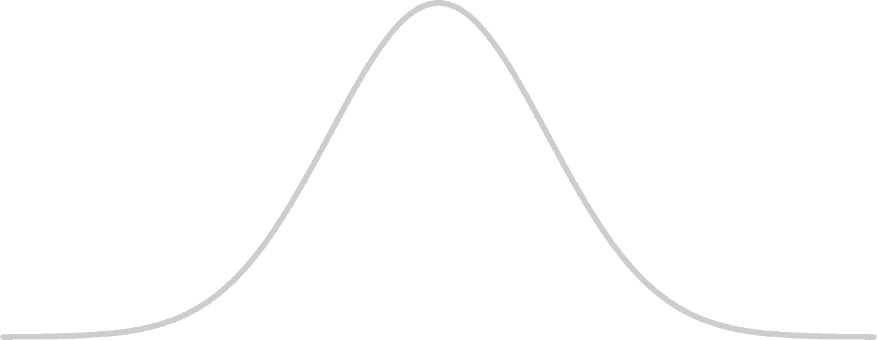
The Normal Distribution
-3σ -2σ -1σ µ +1σ +2σ +3σ

Slide 96
The Normal Distribution
A theoretical probability distribution for a continuous random variable
Sometimes (inappropriately) referred to as the bell-shaped curve or distribution
One of the most important distributions because of its wide range of practical applications

Slide 97
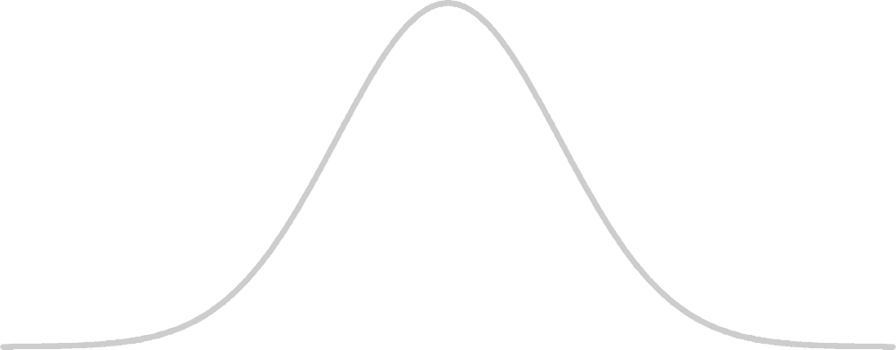
The Normal Distribution
-3σ
Mean = Median = Mode
Symmetrical around µ
Tails extend to ∞
-2σ -1σ µ +1σ +2σ +3σ
γ₃ = 0.00
γ₄ =0.00
Areas under the curve are predictable based upon standard deviation values.
but never touch the horizontal axis

Slide 98


Areas Under the Normal Curve
34.135% 34.135%
13.590%
13.590%
2.140%
2.140%
0.135%
0.135%
µ
-3σ -2σ -1σ
1σ
2σ
3σ
68.27%
95.45%
99.73%

Slide 99
The Normal Distribution
-3σ -2σ -1σ µ +1σ +2σ +3σ
1
(𝑋 − 𝜇)²
𝑓(𝑋) = 𝑒𝑥𝑝 −
𝜎 2𝜋
2𝜎²

Slide 100
Area Calculations
The area corresponding to any score value may be found using a z-score, where
𝑋 − 𝜇
𝑧 =
𝜎
Z is the number of standard deviation units
from X to µ

Slide 101
Example
To date, tooling used on a particular drilling process has lasted an average of 180 hours before requiring replacement, with a standard deviation of 5 hours.

Slide 102
Example
What is the probability that a tool selected at random from the tool crib will last less than 172 hours before replacement is required?

Slide 103
Example
𝑋 − 𝜇
𝑧 =
𝜎
172 − 180
𝑧 =
5
𝑧 = -1.60
165 170 175 180 185 190 195
172
Z
-3 -2 -1 0
1 2 3

Slide 104
Normal Distribution in RStudio
In R / Rstudio
pnorm(q, mean, sd, lower.tail)

Slide 105
Example 2
A stamping operation has been running consistently, punching two holes in sheet metal.

Slide 106
Example 2
The center-to-center distance between the two holes has been an average (μ) of 5.20mm, with a standard deviation (σ) of 0.05mm.

Slide 107
Example 2
The process produces center-to-center distances that can be modeled with a normal distribution.

Slide 108
Example 2
The specifications for these parts require a maximum, or upper (USL), limit of 5.35mm and a minimum, or lower (LSL), limit of 5.15mm.
What percentage of the manufactured parts are likely to fall outside of the specifications?

Slide 109
Example
𝑋 − 𝜇
𝑧 =
𝜎
5.05 5.10 5.15 5.20 5.25 5.30 5.35
Z
-3 -2 -1 0
1 2 3

Slide 110
Normal Distribution in RStudio
In R / Rstudio
pnorm(q, mean, sd, lower.tail)

Slide 111
Testing for Normality
When n < 25, use the Anderson-Darling test for normality (double check with Shapiro-Wilk test).
When n ≥ 25, use the skewness and
kurtosis tests (D’Agostino).

Slide 112
Testing for Normality in RStudio
In R / Rstudio
anderson.darling.normality.test( ) shapiro.wilk.normality.test( ) or summary.continuous( )
dagostino.normality.omnibus.test( ) or summary.continuous( )

Slide 113
Sources
The material used in the PowerPoint presentations associated with this course was drawn from a number of sources. Specifically, much of the content included was adopted or adapted from the following previously-published material:
Luftig, J. An Introduction to Statistical Process Control & Capability. Luftig & Associates, Inc. Farmington Hills, MI, 1982
Luftig, J. Advanced Statistical Process Control & Capability. Luftig & Associates, Inc. Farmington Hills, MI, 1984.
Luftig, J. A Quality Improvement Strategy for Critical Product and Process Characteristics. Luftig & Associates, Inc. Farmington Hills, MI, 1991
Luftig, J. Guidelines for Reporting the Capability of Critical Product Characteristics. Anheuser-Busch Companies, St. Louis, MO. 1994
Spooner-Jordan, V. Understanding Variation. Luftig & Warren International, Southfield, MI 1996
Luftig, J. and Petrovich, M. Quality with Confidence in Manufacturing. SPSS, Inc. Chicago, IL 1997
Littlejohn, R., Ouellette, S., & Petrovich, M. Black Belt Business Improvement Specialist Training, Luftig & Warren International, 2000
Ouellette, S. Six Sigma Champion Training, ROI Alliance, LLC & Luftig & Warren, International, Southfield, MI 2005

Slide 114
The Exponential Distribution
Data Science for Quality Management: Probability and Probability Distributions
with Wendy Martin

Slide 115
Learning objectives:
Describe the Exponential probability distribution
Calculate probabilities using the Exponential distribution

Slide 116
The Exponential Distribution
µ
x
^{X}min

Slide 117
The Exponential Distribution
The exponential distribution occurs in a number of situations in the industrial environment.
Time to failure often follows an exponential distribution.

Slide 118
The Exponential Distribution
Measurement from a physical process that has a restraint, such as the location of a hole from a reference edge, where the reference edge is pressed against a fixture, may follow an exponential distribution.

Slide 119
The Exponential Distribution
Roundness of shaft, measured by total indicator reading, may also follow this type of distribution.

Slide 120
The Exponential Distribution
The exponential distribution is a continuous random variable probability distribution with the form:
1
₋𝑥−𝑥_{𝑚𝑖𝑛}
𝑦 =
𝑒
𝜇−𝑥_{𝑚𝑖𝑛}
𝜇 − 𝑥_{𝑚𝑖𝑛}

Slide 121
The Exponential Distribution
When x_{min} = 0, the equation reduces to:
1
₋𝑥
𝑦 =
𝑒
𝜇
𝜇

Slide 122
The Exponential Distribution
The normal distribution contains an area of
50% above and 50% below µ.
With the exponential distribution, 36.8% of the area under the curve is above the average (µ) and 63.2% is below.

Slide 123
Applications / Observations
Predictions based on an exponentially distributed process often only require the µ (and sometimes x_{min}) of the process.

Slide 124
Applications / Observations
For prediction purposes, finding the area under the curve beyond the time period of concern is generally the point of interest.
These prediction often relate to reliability issues or time between failure analyses.

Slide 125
Example 1
An in-plant study has shown that an engine control module laboratory tester is capable of operating on an average of 100 hours between breakdowns (MTBF).

Slide 126
Example 1
What is the probability that the tester will run for at least 60 successive hours without a breakdown (assuming that the time to failure pattern is distributed exponentially)?

Slide 127
Example 1
₋𝑥
𝑃(𝑥 𝑜𝑟 𝑚𝑜𝑟𝑒) = 𝑒
𝜇
µ =100
60
−
= 𝑒 = 0.5488
100
0 60
x

Slide 128
Exponential Distribution in RStudio
pexp(q, rate, lower.tail)

Slide 129
Example 2
The distribution of time for a particular grinding machine is characterized by the exponential distribution.
The mean time between breakdowns has been established at 50 minutes.

Slide 130
Example 2
The origin parameter (x_{min}) is estimated to be 5 minutes.
What is the probability of this machine running 20 minutes or less before a breakdown?

Slide 131
Example 2
𝑥−𝑥
−
𝑚𝑖𝑛
𝜇−𝑥_{𝑚𝑖𝑛}
𝑃 𝑥 𝑜𝑟 𝑙𝑒𝑠𝑠
= 1 − 𝑒
₋20−5
µ = 50
= 1 − 𝑒
50−5
= 0.2835
5 20
x

Slide 132
Exponential Distribution in RStudio
pexp(q, rate, lower.tail)

Slide 133
Testing for Exponentiality
When n ≤ 100, use the Shapiro-Wilk test
When n > 100, use the Epps and Pulley test

Slide 134
Testing for Exponentiality
In R / Rstudio
shapiro.wilk.exponentiality.test( )
shapetest.exp.epps.pulley.1986( )

Slide 135
Sources
Luftig, J. An Introduction to Statistical Process Control & Capability. Luftig & Associates, Inc. Farmington Hills, MI, 1982

